Slide 1
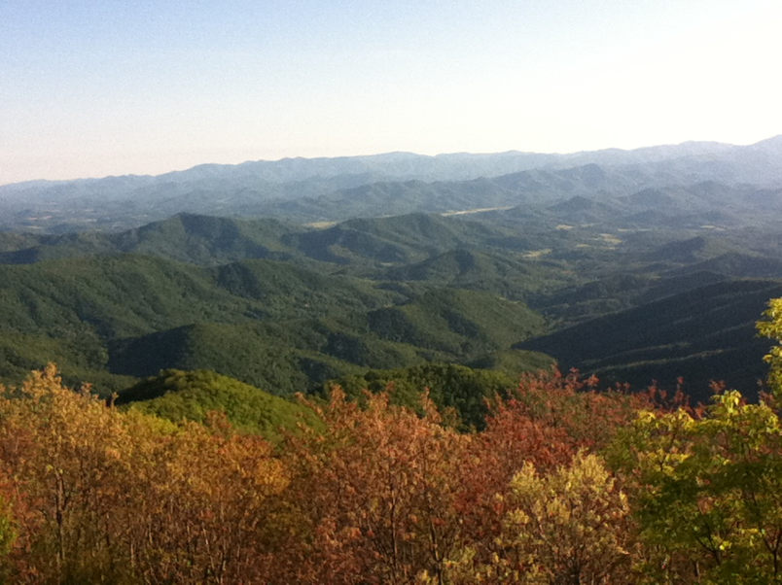



Reproducible geographic analysis: Insights from geomorphology
Stuart Grieve

Slide 2
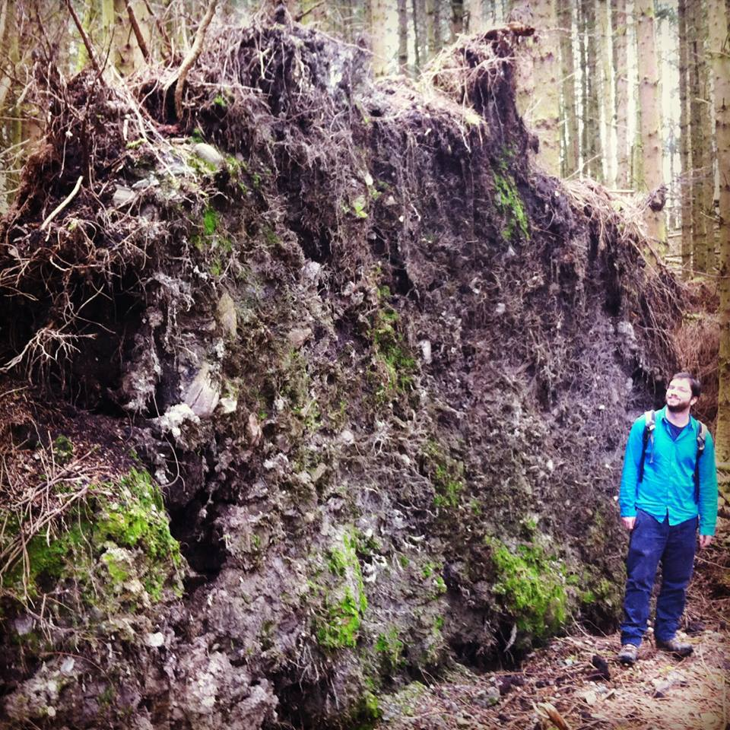
About me
BSc in Geology and Physical Geography
GIS MSc in 2012
Geomorphology PhD 2013-2017
Hillslope geomorphology
Topographic analysis
Software

Slide 3
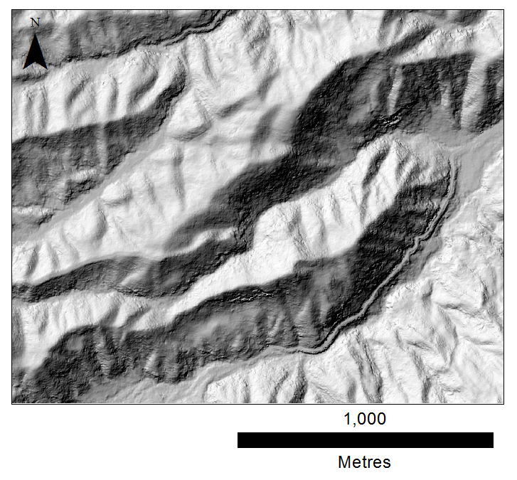
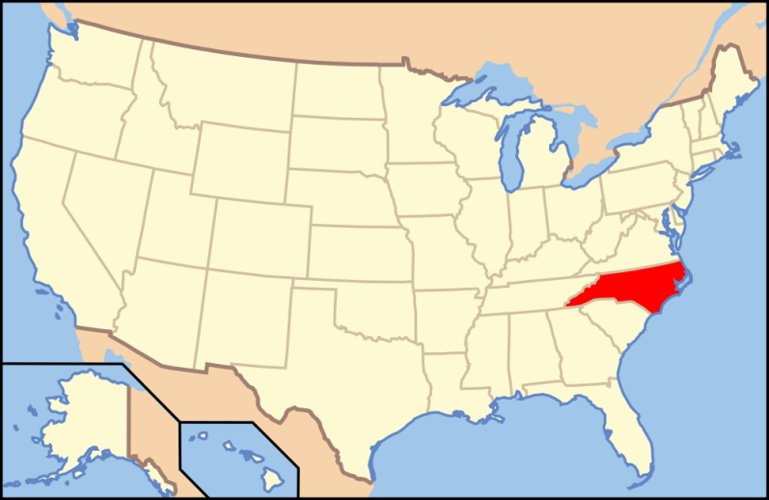
PhD Overview
Studying shallow landslide initiation zones
Macon County, NC

Slide 4
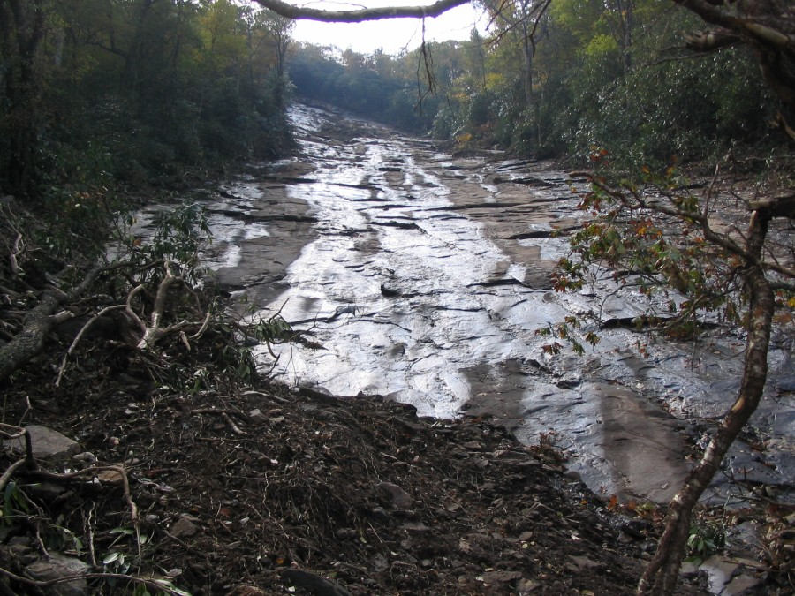
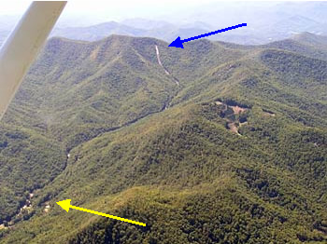
Peek’s Creek debris flow
Hurricanes Francis and Ivan
Debris flow triggered during heavy rain
Flow reached settlement at Peek’s Creek
Photos courtesy of NOAA & NCGS

Slide 5
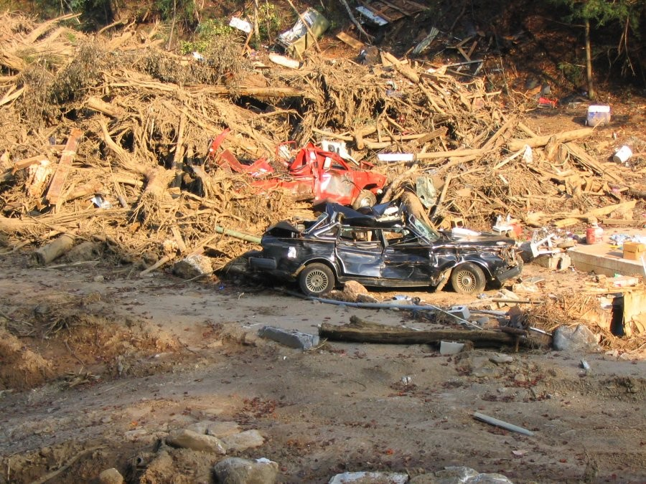
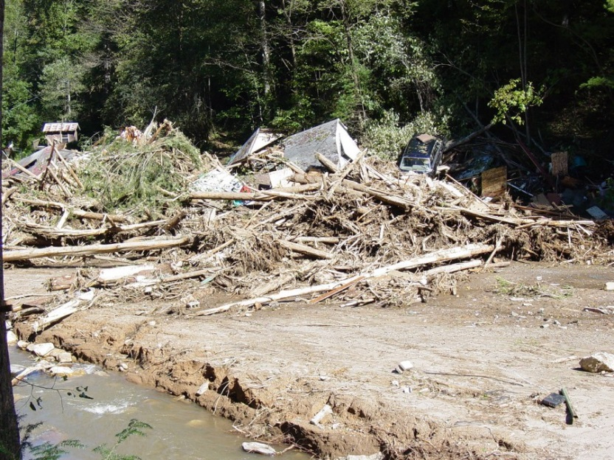
Peek’s Creek debris flow
5 dead, 30 injured
15 homes destroyed
One of 300 events mapped since 2004
Serious hazard
Getting more common?
Photos courtesy of NOAA & NCGS

Slide 6
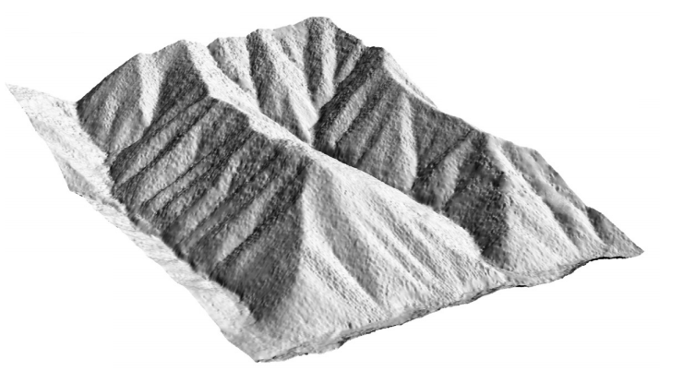
Topographic analysis
Topographic form is key to understanding:
Where landslides will initiate
How these events are triggered
How far will they travel downslope
Topographic analysis requires GIS!
[Roering et al., 2007]

Slide 7
GIS and geomorphology
Modern geomorphology has heavy reliance on GIS
DEMs
Point Clouds
Laser Scanning
DGPS
Vast majority of data collected is GIS linked
Geomorphology’s development has followed technical developments in GIS closely

Slide 8
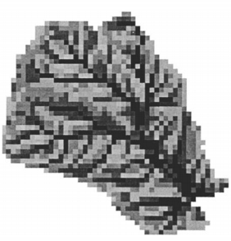
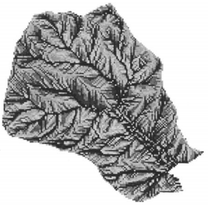
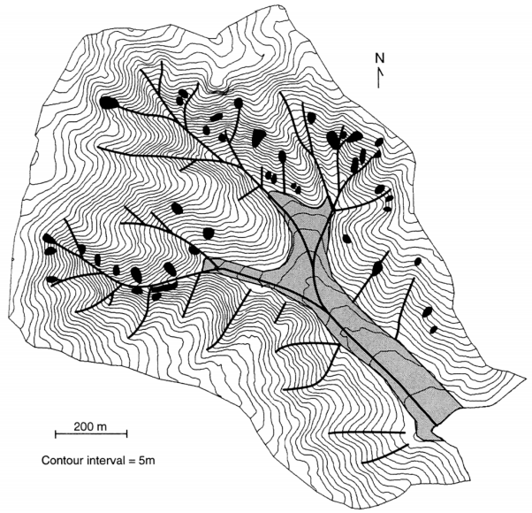
GIS and geomorphology
Early research generated digital elevation data using photogrammetry or digitising topographic maps
[Zhang and Montgomery, 1994]
[Montgomery and Dietrich, 1994]

Slide 9
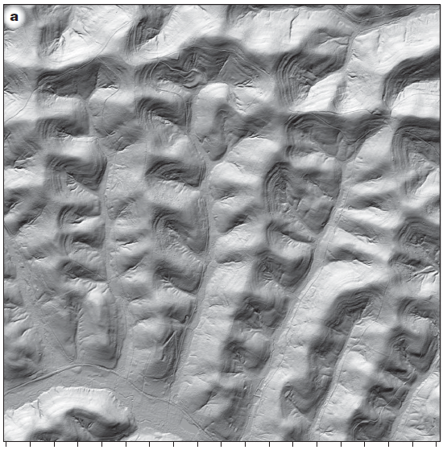
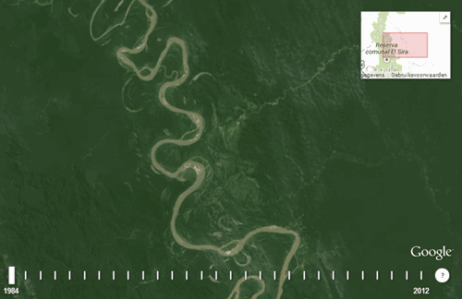
GIS and geomorphology
Modern work now harnesses high spatial and temporal resolution data
[Perron et al., 2008]

Slide 10
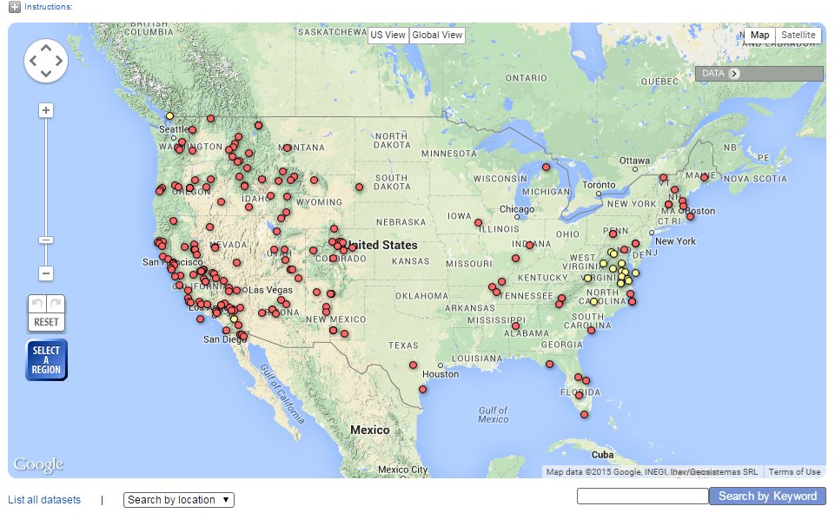
GIS and geomorphology
Unprecedented access to data

Slide 11

GIS and geomorphology
Research being performed with cutting edge technology
E.g. Kinect
[Mankoff et al., 2013]

Slide 12
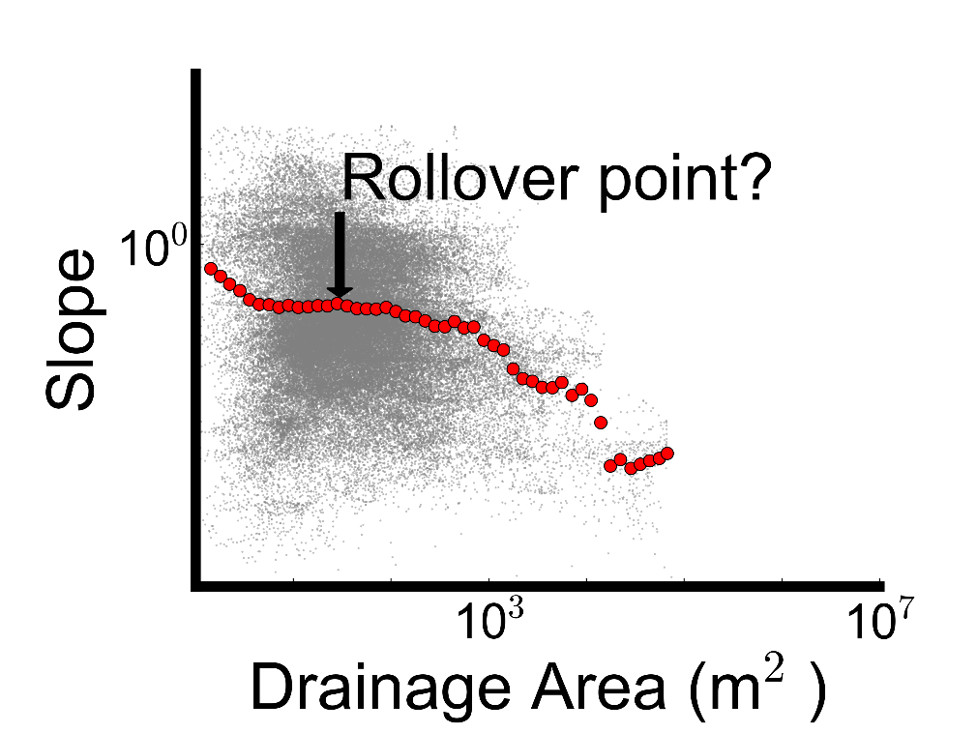
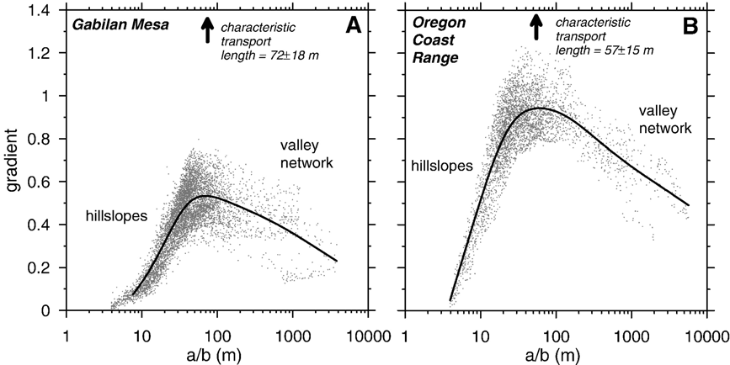
Lots of data!
Are we able to reproduce results?
How can we perform science if we cannot reproduce other peoples results?

Slide 13
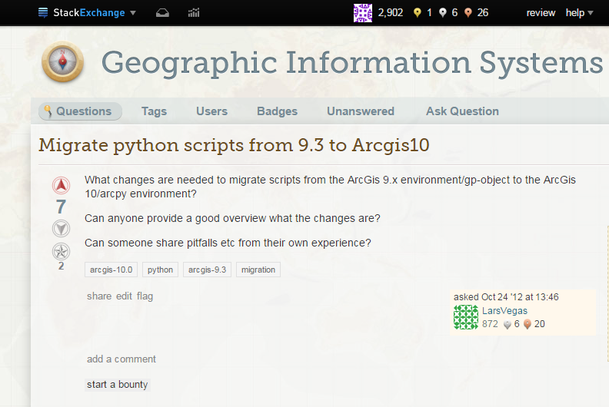
Causes of non-reproducibility
Black box software
Do we know what is happening behind the scenes?
Will my analysis routines still work in the new version?

Slide 14
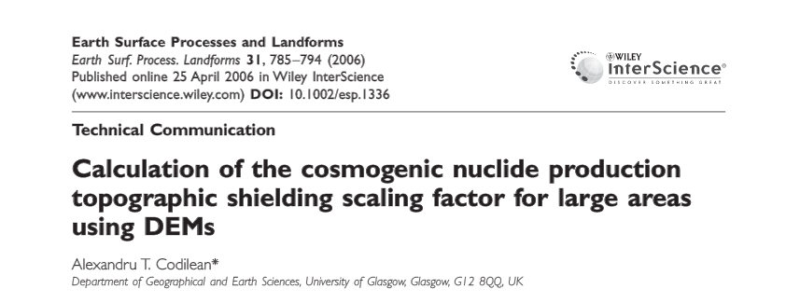
Causes of non-reproducibility
Obsolete software
How many people can still use avenue?

Slide 15
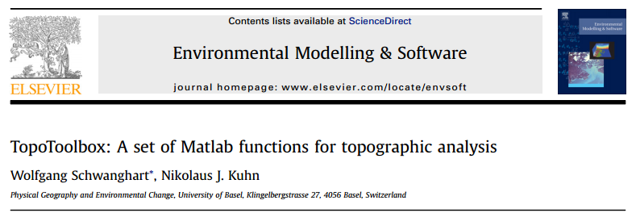
Causes of non-reproducibility
Vendor lock in
e.g. MATLAB
Not all institutions have licences
Open access publication but not analysis
Creates 2 tier peer review system

Slide 16
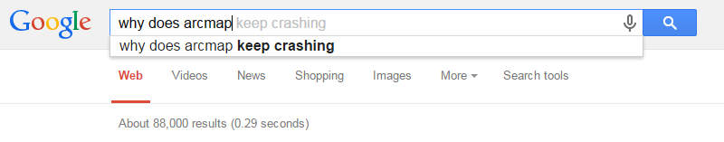
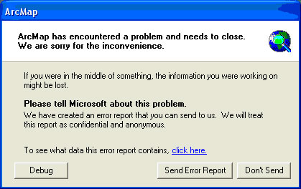
Causes of non-reproducibility
Software instability
What do you do if your published methodology causes crashes?

Slide 17


Causes of non-reproducibility
Missing or poor documentation
How can we make it as easy as possible for people to reproduce a technique?
Video
Wiki
Q&A engines
Help files
Blogs

Slide 18
Not just a geomorphology issue
Everyone here will (hopefully) relate to some of the previous examples
Can your company repeat analysis?
In a week?
In a year?
If someone leaves?
Are you confident that you understand how the results were produced?

Slide 19
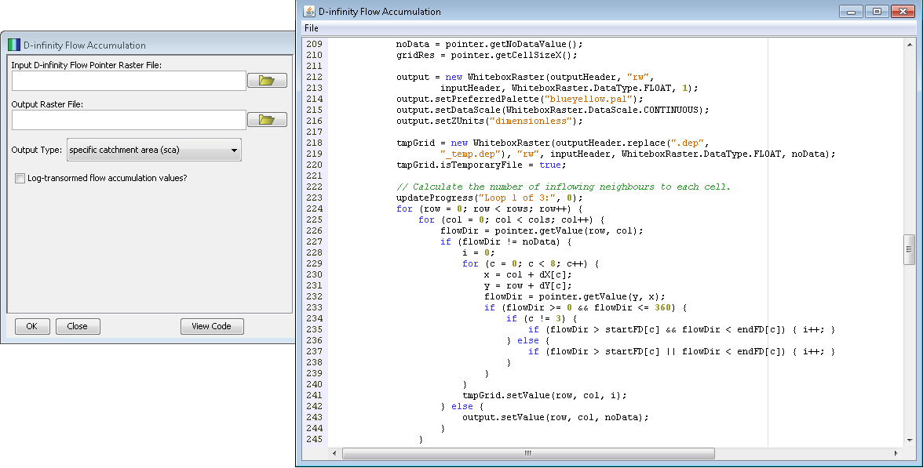
A major challenge
Reproducibility is becoming increasingly important
More data
More options for data analysis
No easy solution
Open source solves some problems
Whitebox GAT

Slide 20
Moving towards reproducibility
We have resolved to make our research as open and reproducible as possible
The result is LSDTopoToolBox
An open source topographic analysis package written in C++
Developed by 6 people over the past 3 years
Over 125,000 lines of code
Over 1200 software revisions
Used in > 30 publications with another 5 currently in review
Users on 4 continents
Beginning to use the software to teach undergraduates

Slide 21
LSDTopoToolBox
Specialises in raster based topographic analysis
Also handles point clouds and ESRI shapefiles
Designed from scratch to have very few dependences and no reliance on commercial software
Only needs TNT and a compiler
Developed for a UNIX environment
Handles very large datasets efficiently
Code has no GUI, to facilitate reproducible analysis

Slide 22
Not just for programmers
Most of our users never write a line of code
Common analyses are linked together into drivers
Most common topographic analyses can be performed by running these files
A driver is released alongside every paper the group puts out

Slide 23
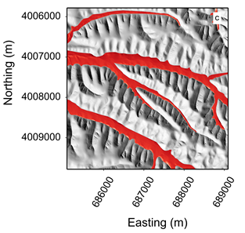
How do we visualise our results?
Could use any GIS package
ArcMap or QGIS, or WhiteBox…
We use Python to produce plotting and visualization routines for common outputs
Also exploring JavaScript to get interactive data visualisation onto the web
Users can go from raw data to publication ready figures without any commercial software

Slide 24
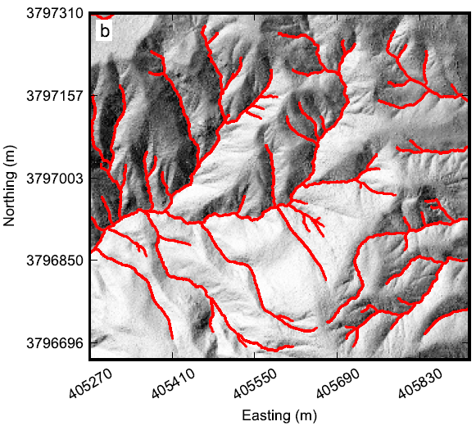
What can LSDTopoToolBox do?
Identify channel initiation zones in high-resolution topography
[Clubb et al., 2014]

Slide 25
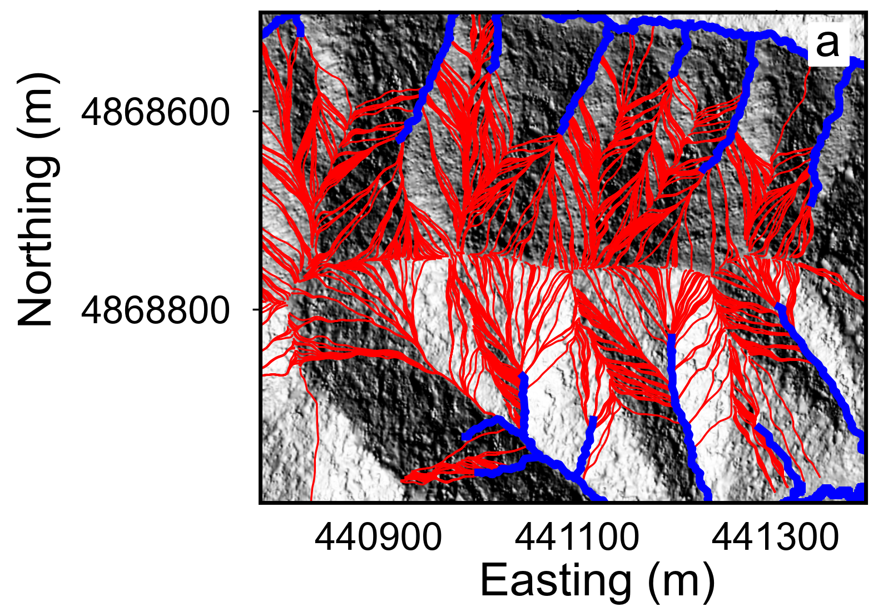
What can LSDTopoToolBox do?
Route flow across hillslopes, connecting drainage divides to channels
[Grieve et al., in prep]

Slide 26
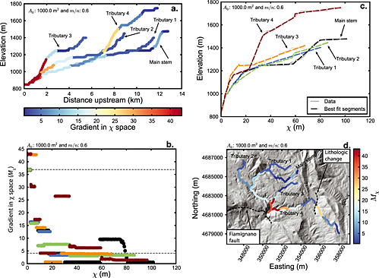
What can LSDTopoToolBox do?
Channel profile analysis
[Mudd et al., 2014]

Slide 27
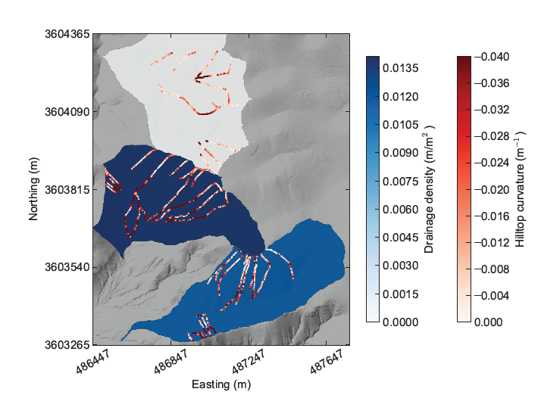
What can LSDTopoToolBox do?
Drainage basin analysis
[Clubb et al., in prep]

Slide 28
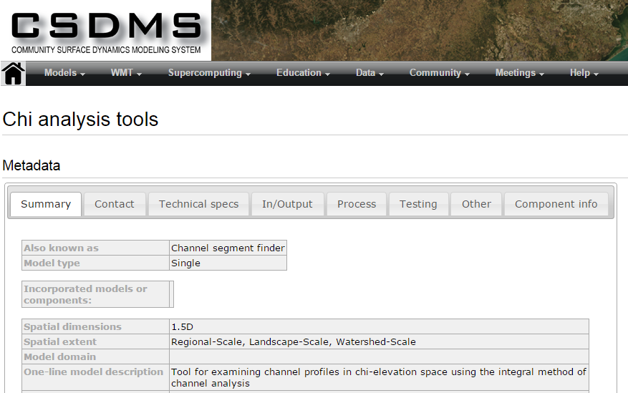
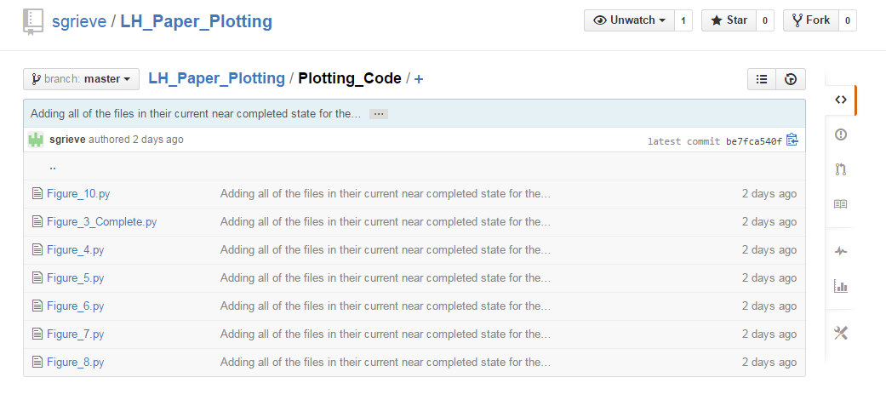
Now we can reproduce our analysis!
We now publish all of our code in parallel with each paper
Reviewers and colleagues can take our raw data and reproduce the figures in our papers
Beginning to recognise figures from LSDTopoToolBox in conference presentations from other groups
Great for collaboration!

Slide 29
Conclusions
Reproducible analysis is challenging
Requires large investment of time and money
Definitely not the easy solution
But will facilitate better research in the long run
Concepts of reproducibility have relevance beyond geomorphology
Hopefully these ideas can improve analysis in the commercial sector too
Interested?
Email me: s.grieve@ed.ac.uk
Check out our documentation: http://bit.ly/1AYM7ru

Slide 30
Acknowledgments
Developers:
Simon Mudd (University of Edinburgh)
David Milodowski (University of Edinburgh)
Martin Hurst (British Geological Survey)
Fiona Clubb (University of Edinburgh)
Declan Valters (University of Manchester)
Thanks to our funders for their support:
Natural Environment Research Council
The Carnegie Trust for the Universities of Scotland
The British Geological Survey
The U.S. Army Research Office

